Slide 1
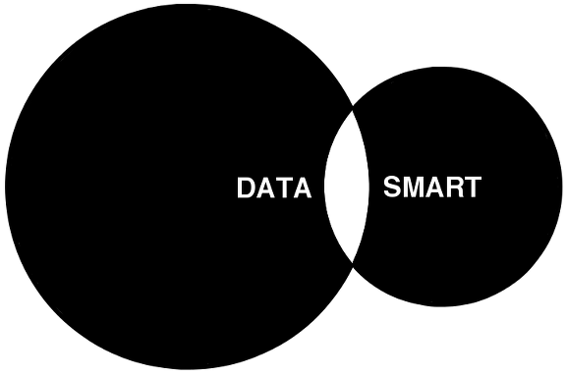
Concept Timestamping on Blockchain and Decentralization of Patents
Dr Loke Kar Seng
G. Wang et al. (Eds.): iSCI 2019, CCIS 1122, pp. 1–10, 2019.

Slide 2
Motivation: Some Issues with Patents
Patent are intellectual property rights
Balance between economic rights and diffusion of knowledge
Patents are issued based on novelty and non-obviousness
Assessment becomes difficult can result in dubious patents - those that have low novelty and low non-obviousness
This leads to stiffling of innovation

Slide 3
Some Remedy Issues of Patent
Expand the number examiners
Use computers to help out by processing documents
Highlight important sections
Improve searching, indexing and retrieval
Use machine learning to automatical classify documents

Slide 4
Alternative Proposal
Use a combination of graphics and blockchain
Specifically use Conceptual Graphs to compare the notion of the patent idea.
Use the blockchain to register the claim - decentralization!!

Slide 5
Conceptual Graphs
A conceptual graph (CG) is a graph-based method for representing structural and semantic relationships between concepts.
CG is based on the ideas of semantic networks and existential graphs .
A CG consist of a network of concept nodes linked by relation nodes.
The concept nodes can represent entities, events, actions, states, attributes etc.

Slide 6
Conceptual Graphs
CG through its simplicity and graphical constructs, it is simple to use and yet sufficiently expressive.
Graphs such as CG have non-linear structures that are make easy to identify similarities and differences.

Slide 7
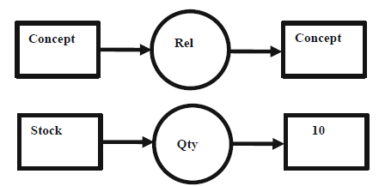
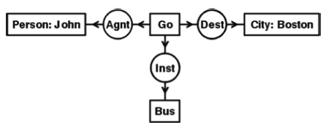
Example CG
the quantity (qty) of the stock is 10
“John is going to Boston by bus”

Slide 8
Examples of use
Medical - tumor clasification representation and querying, patient data description
Image retrieval based on CG
Software requirements documentation
Business process documentation

Slide 9
CG Use in Patents
Patent filing summarization using CG
Using CG for graph matching

Slide 10
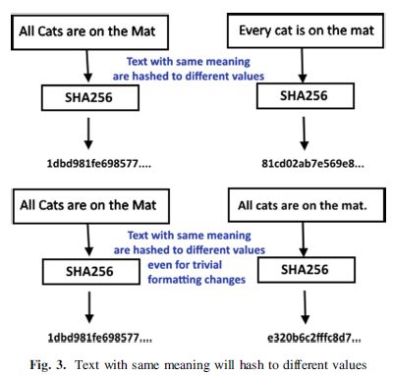
Our Approach
Language (and text) itself is very expressive and can express the same semantical contents with an infinite variety of ways

Slide 11
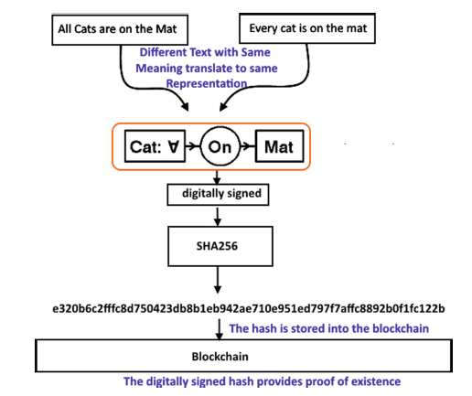
Our Approach
Timestamping on blockchain for documents only provide proof of existence of a particular document but NOT its contents.
What we are trying to do is to do semantic timestamping - to capture the contents rather than its representation.

Slide 12
Our Approach
The existence of a hash for a document does not rule other possible text that has the same content.
On the other hand, concepts represented by CG should not differ if they are indeed the same concept, so we would have a unique representation of it as the hash.
If the idea in the CG creates a collision in the hash, then we would know that the idea is not unique and should be rejected by the system.
The centralization of patents through a governmental entity can be done away by registering the canonical CG on the Blockchain.

Slide 13
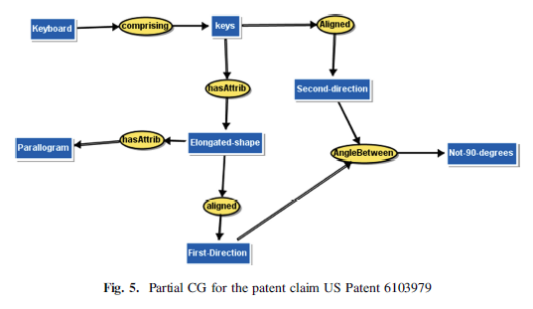
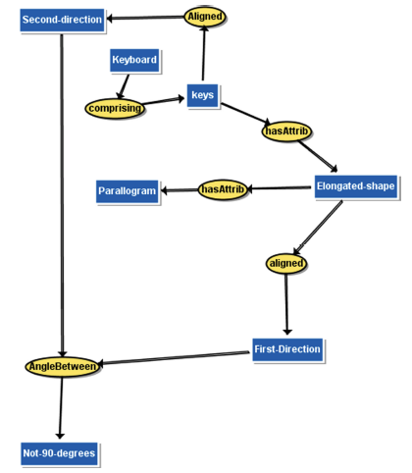
Brief Example
[Not-90-degrees: *x1] [Second-direction: *x2] [First-Direction: *x3] [Elongatedshape:
*x4] [Keyboard: *x5] [keys: *x6] [Parallogram: *x7] (comprising ?x5
?x6)(hasAttrib ?x6 ?x4)(aligned ?x4 ?x3)(hasAttrib ?x4 ?x7)(Aligned ?x6
?x2)(AngleBetween ?x3 ?x2 ?x1)

Slide 14
Conclusion
In summary we propose the use of CG as a representation of ideas and concepts for the purpose of making a claim of priority.
Secondly, we have proposed a low-cost, universal, borderless and decentralized system for filing priority that obviates the use of any centralization through the use of the Blockchain.
In addition, the uniqueness of the idea can be checked automatically using semantic graph matching algorithms.

